Slide 1
Tree Diseases & Pests to Watch for in 2019 Northern Green January 16, 2019 Chad P. Giblin Department of Forest Resources - University of Minnesota

Slide 2
Contacts & Links
Chad Giblin
giblin@umn.edu
Urban Forestry Outreach, Research & Extension (UFore) Nursery and Lab
trees.umn.edu

Slide 3
Japanese Beetle
Ronald S. Kelley, Vermont Department of Forests, Parks and Recreation, Bugwood.org
Notes:
Adult Control (Contact)
- Foliar spray (bifenthrin)
Longer-Term Controls
Acephate
Quick action, lasts about one month
Imidacloprid
– longer residual but takes time to reach leaves

Slide 4
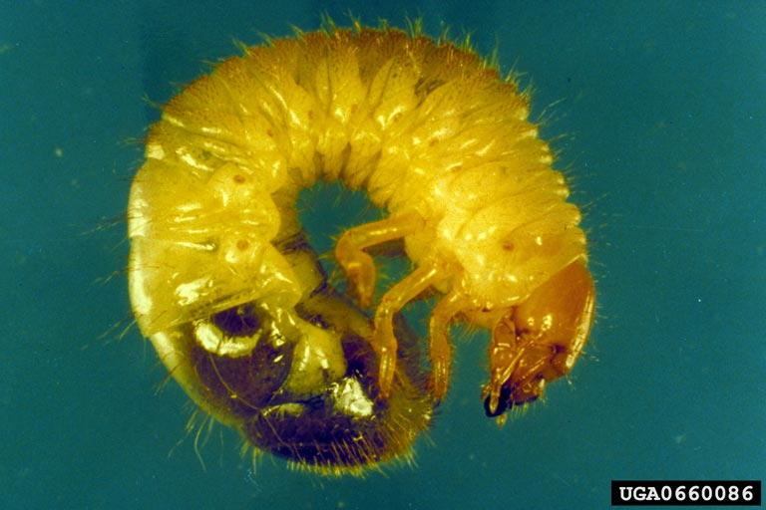
Japanese Beetle
USDA Agricultural Research Service , USDA Agricultural Research Service, Bugwood.org

Slide 5
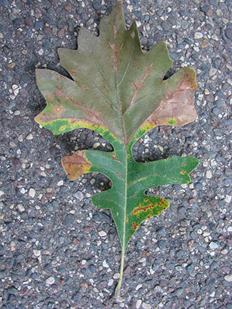
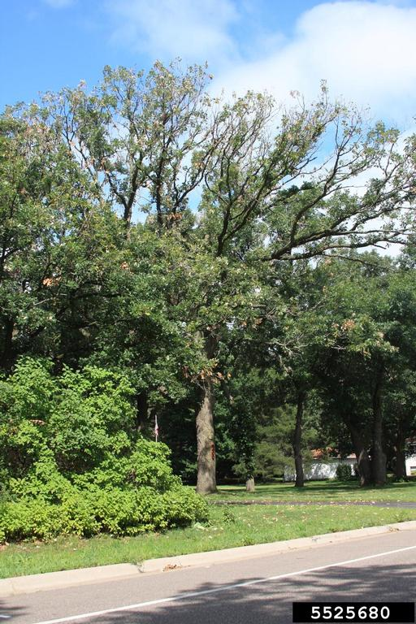
Bur Oak Blight
Steven Katovich, USDA Forest Service, Bugwood.org
Notes:
Foliar disease, can cause extensive defoliation – often for consecutive years.
Avoid stress, primarily.
Macro infusion (propiconazole) is currently being studied but isn’t 100% effective.
May increase susceptibility to oak wilt and two-lined chestnut borer

Slide 6
Two-Lined Chestnut Borer
USDA Forest Service - Northeastern Area , USDA Forest Service, Bugwood.org
Notes:
Native Borer
Avoid stress, apply mulch, water when needed
Dinotefuran
Soil drench, quick effect, shorter residual
Imidacloprid
- Soil drench, annual application, spring or fall applied

Slide 7
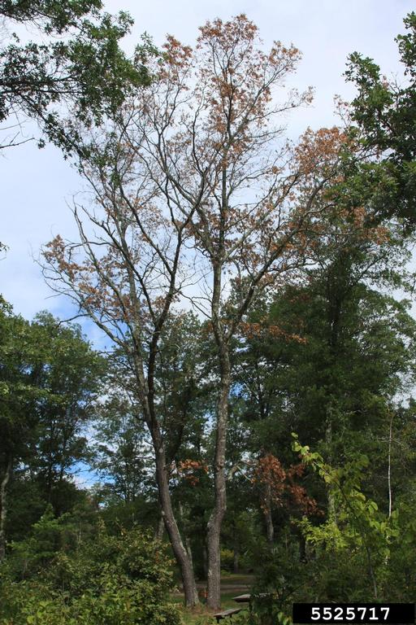
Two-Lined Chestnut Borer
James Solomon, USDA Forest Service, Bugwood.org
Steven Katovich, USDA Forest Service, Bugwood.org

Slide 8
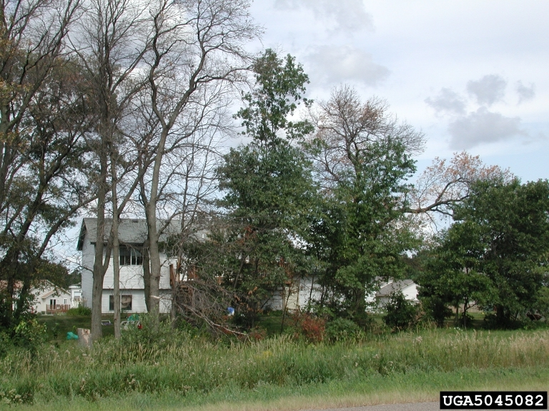
Oak Wilt
Joseph OBrien, USDA Forest Service, Bugwood.org
Notes:
Potentially lethal vascular wilt
Avoidance of infection is best
No pruning or damage April to July
Currently controlled using macro infusion
Research exploring micro injections also underway
Sever roots to control spread in dense stands

Slide 9
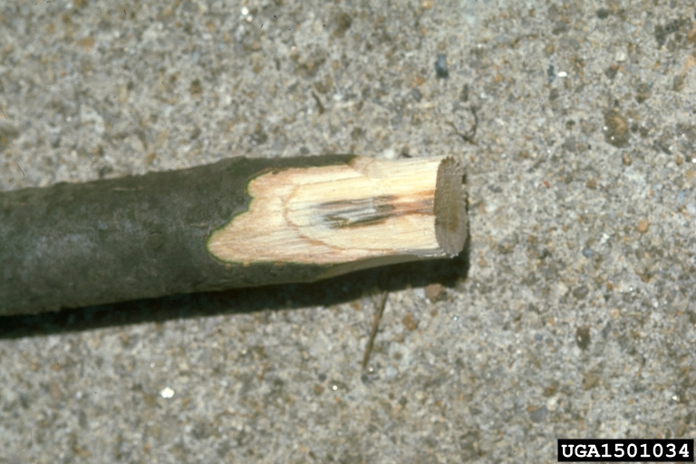
Oak Wilt
Robert F. Bassett, USDA Forest Service, Bugwood.org

Slide 10
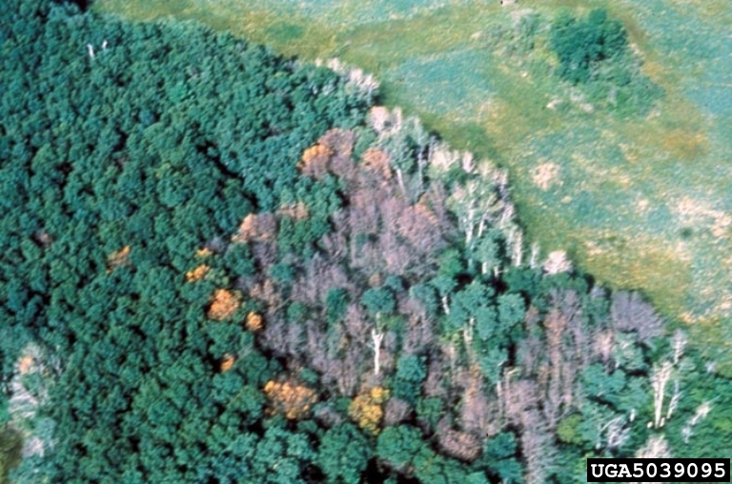
Oak Wilt
Joseph OBrien, USDA Forest Service, Bugwood.org

Slide 11
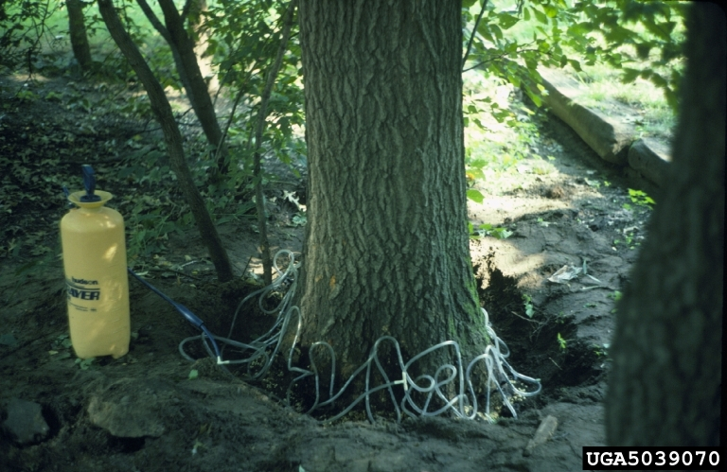
Oak Wilt
Joseph OBrien, USDA Forest Service, Bugwood.org

Slide 12
Oak Wilt
Continues to move north and northwest in Minnesota
Morrison Cty.
Saint Croix S.P.
MN DNR involved in eradication efforts to halt
2018 Confirmed in Bayfield & Douglas Counties in WI

Slide 13
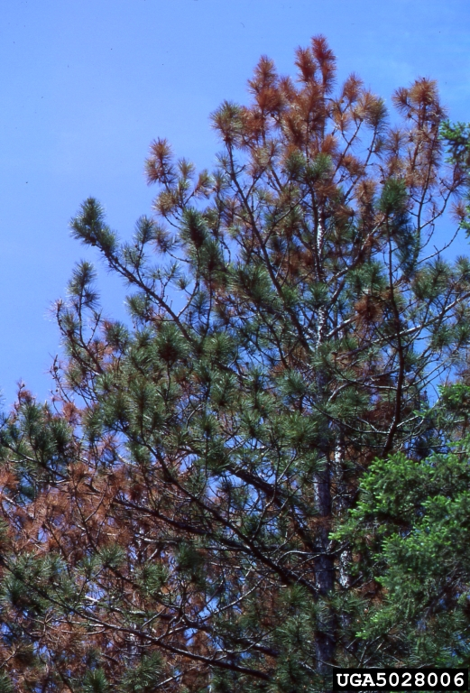
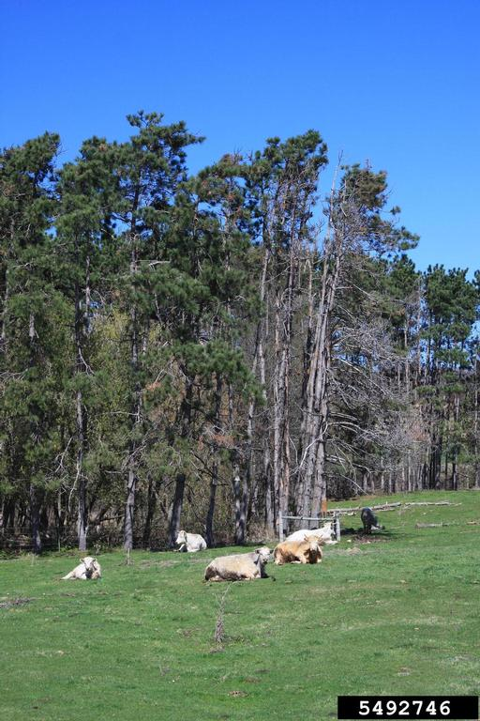
Diplodia Tip Blight
Joseph OBrien, USDA Forest Service, Bugwood.org
Steven Katovich, USDA Forest Service, Bugwood.org
Notes:
Affects Austrian (mostly), Scots, mugo, red pines
Usually middle-aged trees
Attacks stressed trees
Spread during wet springs
Increase water & mulch to reduce stress
Plant growth regulators may offer some hope for recovery
Copper hydroxide applications

Slide 14
But What About….?
Dutch elm disease
Emerald Ash Borer
Asian Longhorned Beetle

Slide 15
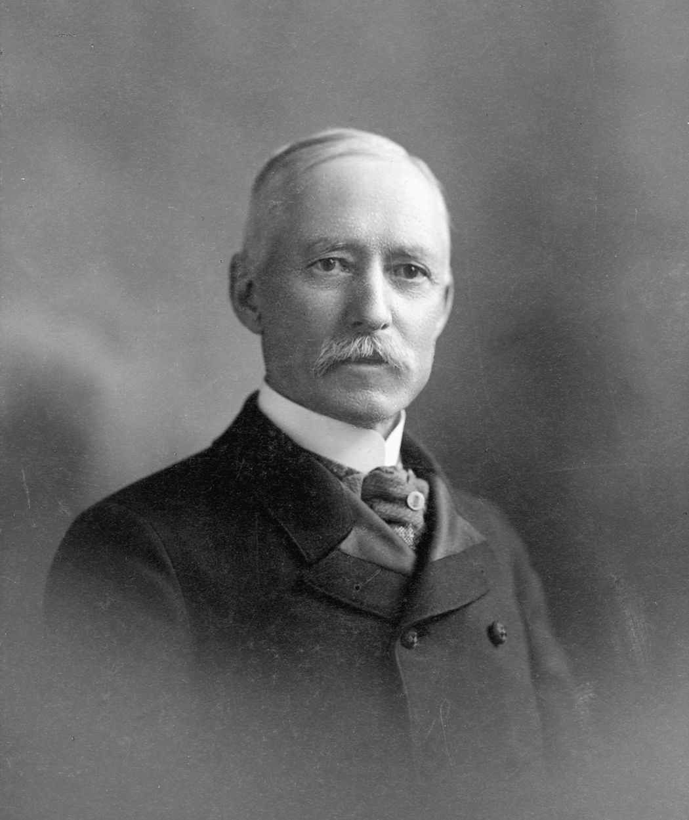
Charles Loring’s Favorite Tree
American Elm!!
Photo: Minnesota Historical Society
Notes:
First President of the Minneapolis Park & Recreation Board “Father of the Parks”
1883-1890

Slide 16
American Elm!
Photo: Minnesota Historical Society
Notes:
Loring paid for the 1,200 elms that lined Victory Memorial Drive.

Slide 17
“…they will in time become giants of strength and beauty.”
American Elm!!
American Elm!!
Photo: Minnesota Historical Society
Notes:
First President of the Minneapolis Park & Recreation Board “Father of the Parks”
1883-1890
Donovan & Butry
“Simply planting street trees without consulting homeowners would be a mistake, as homeowners place different values on different types of trees. Indeed, some
homeowners do not like trees of any type: they block views, drop leaves, and can damage pavements. For these reasons, a subsidy or property-tax break might be an appropriate way to increase the number of street trees. Homeowners would be free to choose the number and type of trees they prefer (given the constraints of the site).”

Slide 18
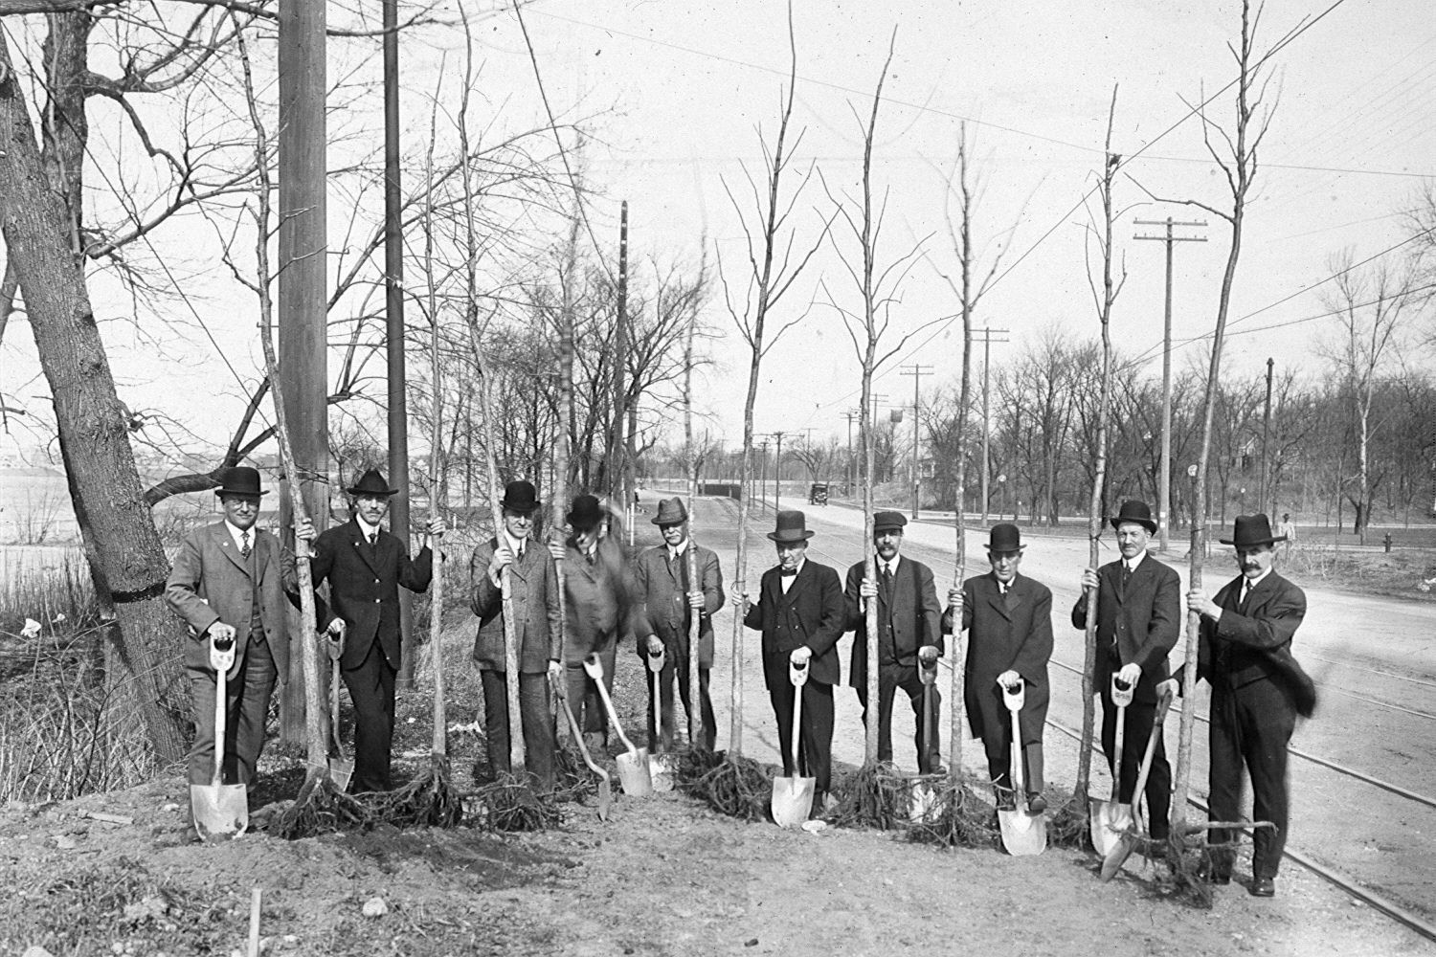
Notes:
1915 or so, pre-electricity?

Slide 19
Pre-1963 over 90% of street trees in Minneapolis were American elm

Slide 20
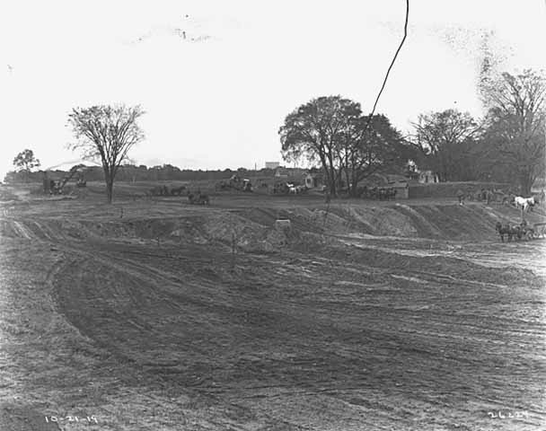
Photo: Minnesota Historical Society
Notes:
Victory Memorial Drive construction, Minneapolis
1919
Completed and planted by 1921
Victory Memorial Drive, near Forty-fifth Avenue North and Xerxes, Minneapolis
1936
MPRB Purchased 1,200 trees of the Moline elm – grafted or budded onto wild rootstocks
1919 into MPRB Nursery- Planted in 1921 on drive
“Moline…known for its shapely beauty and tendency to grow into an imposing specimen.” Theo. Wirth
1922-1925 severe winter losses, strange because Moline did well in other parks in the city.
Wild-type seedlings had to be used because elm stocks were so depleted nationwide.

Slide 21
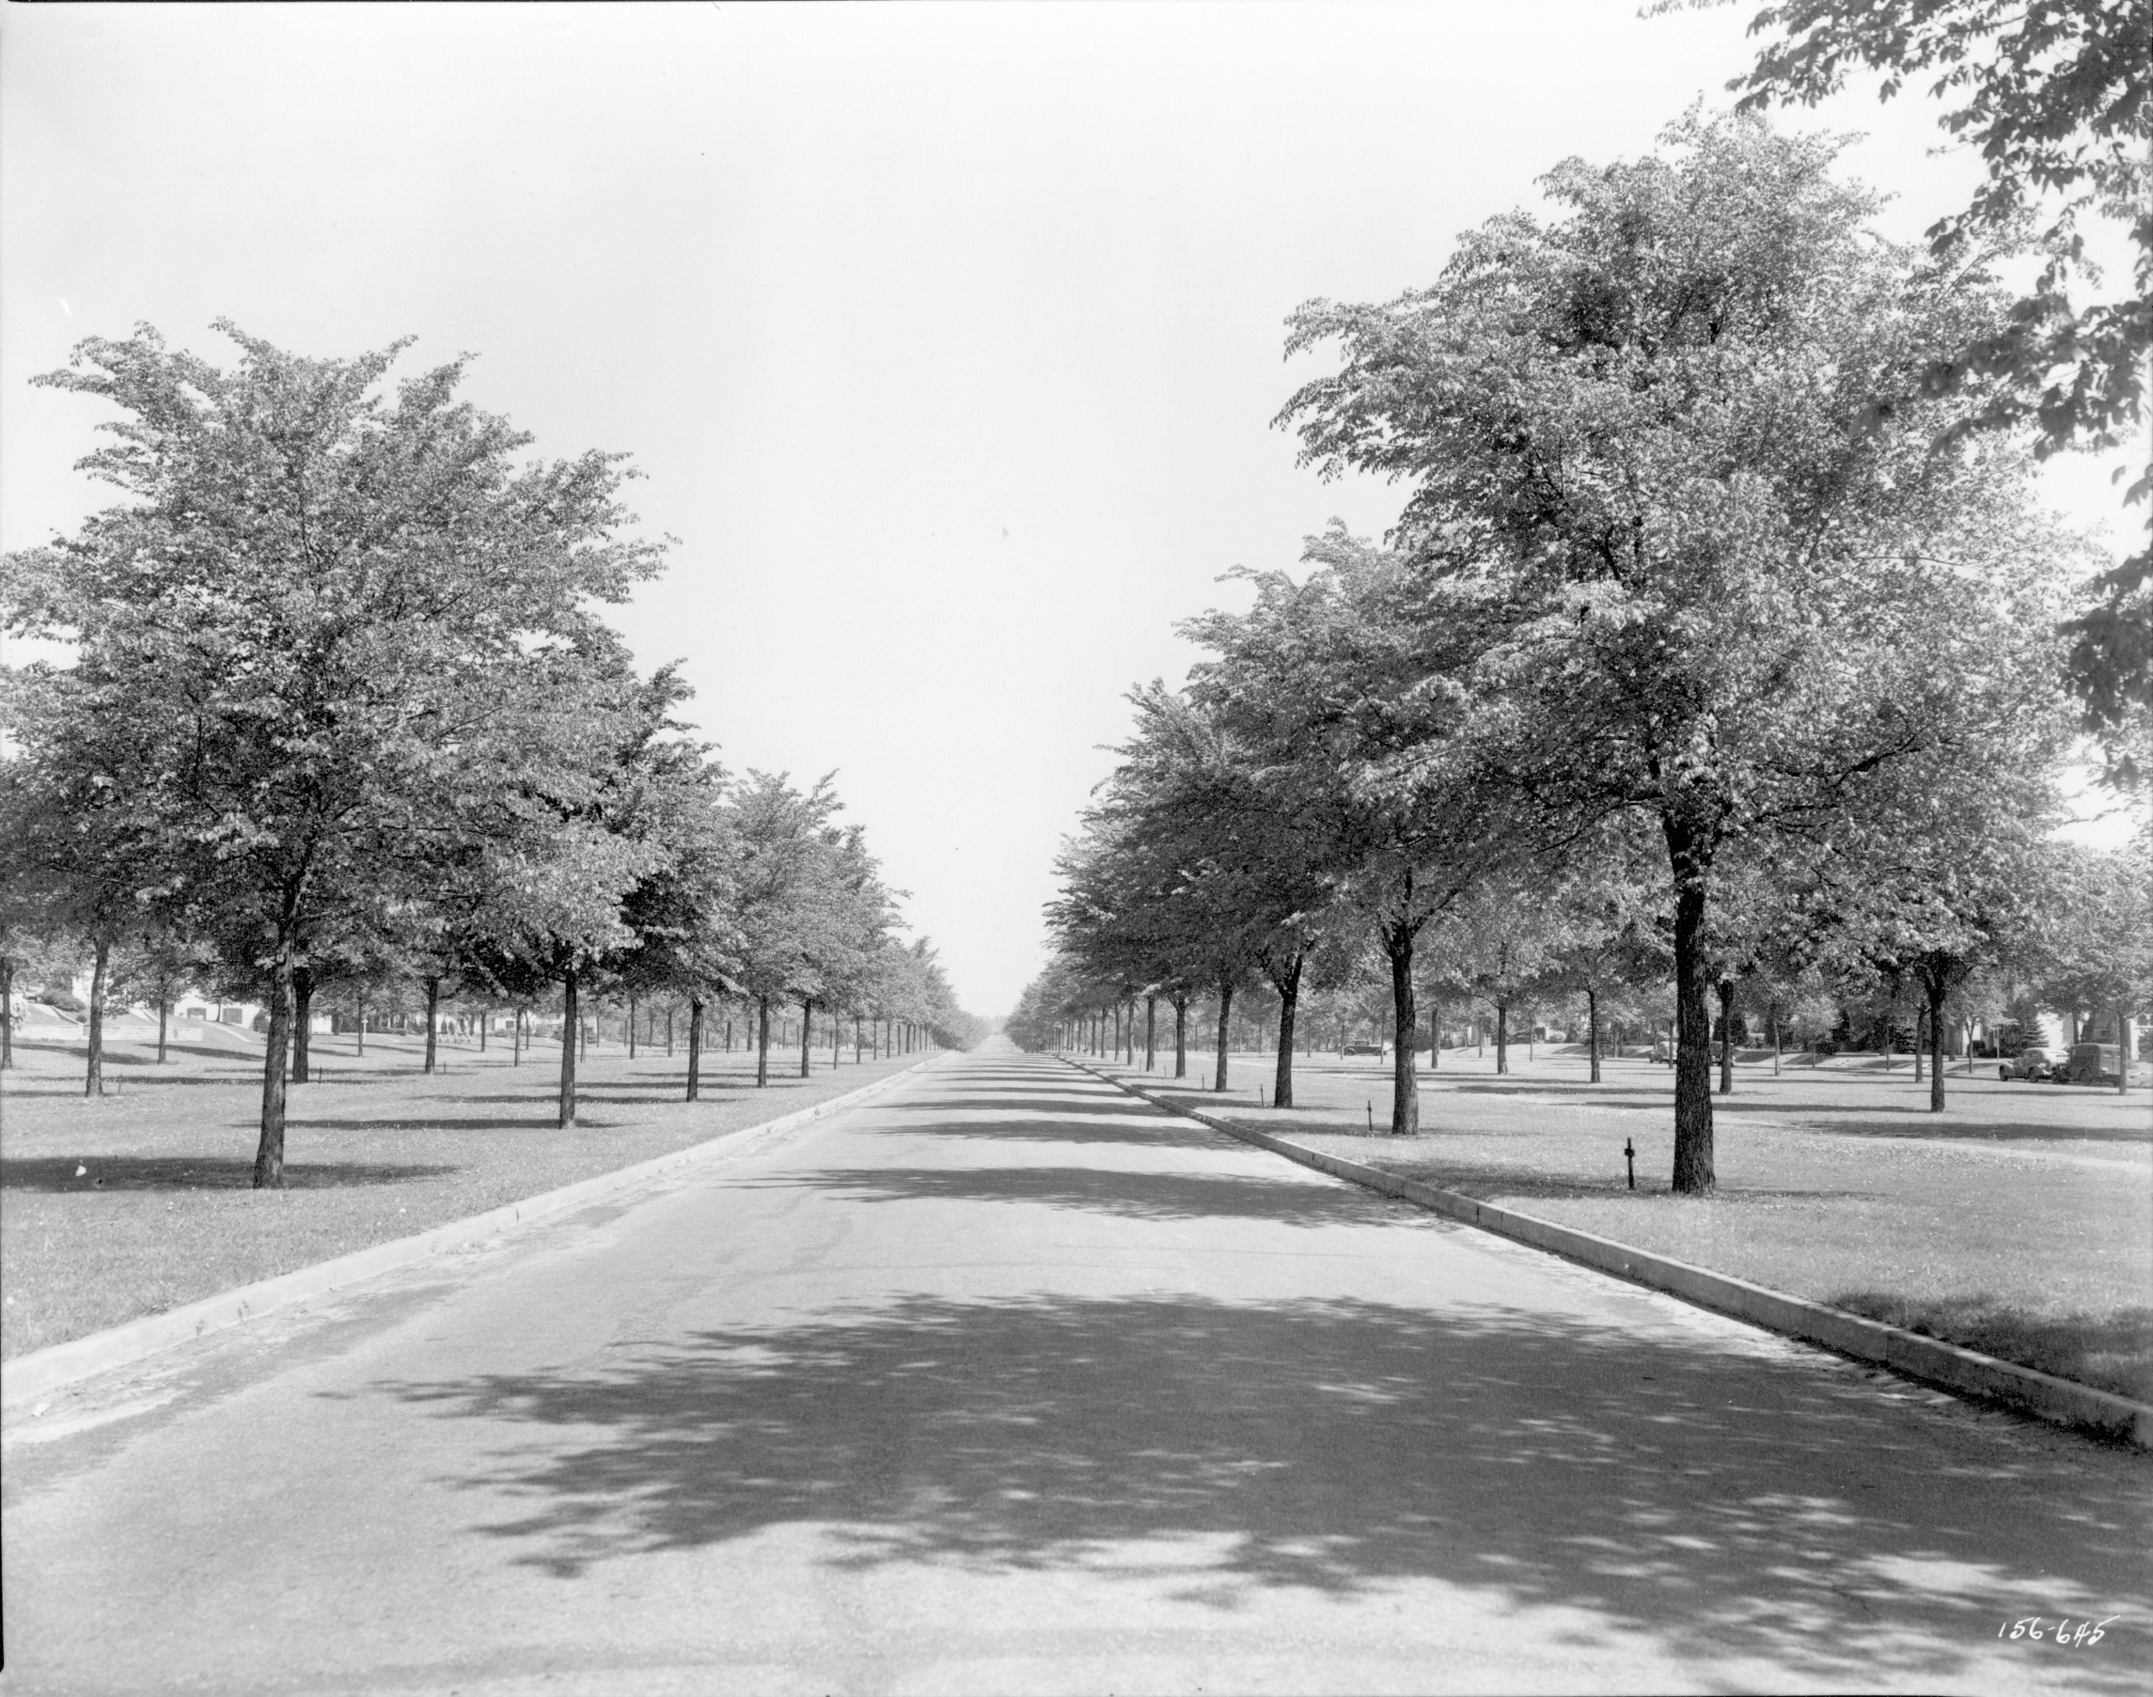
Minnesota Historical Society
Photo: Minnesota Historical Society
Notes:
1945
24 years after planting

Slide 22
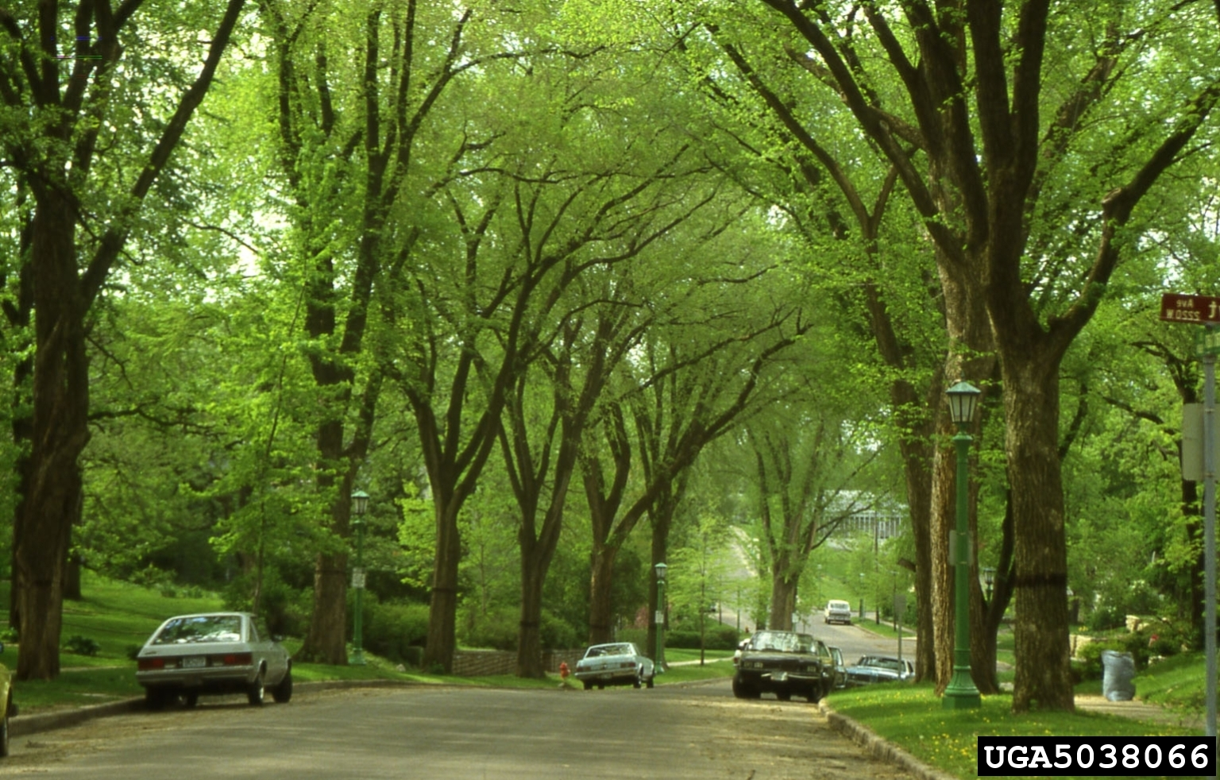
Joseph O'Brien, USDA Forest Service, Bugwood.org
Notes:
Typical view of Minneapolis streets in the early 1970s
Incredible tolerance to urban stresses
Heat
Drought
Flooding
Easy establishment and very fast growth
Despite nursery production many trees were just dug from the wild and planted where needed.
22

Slide 23
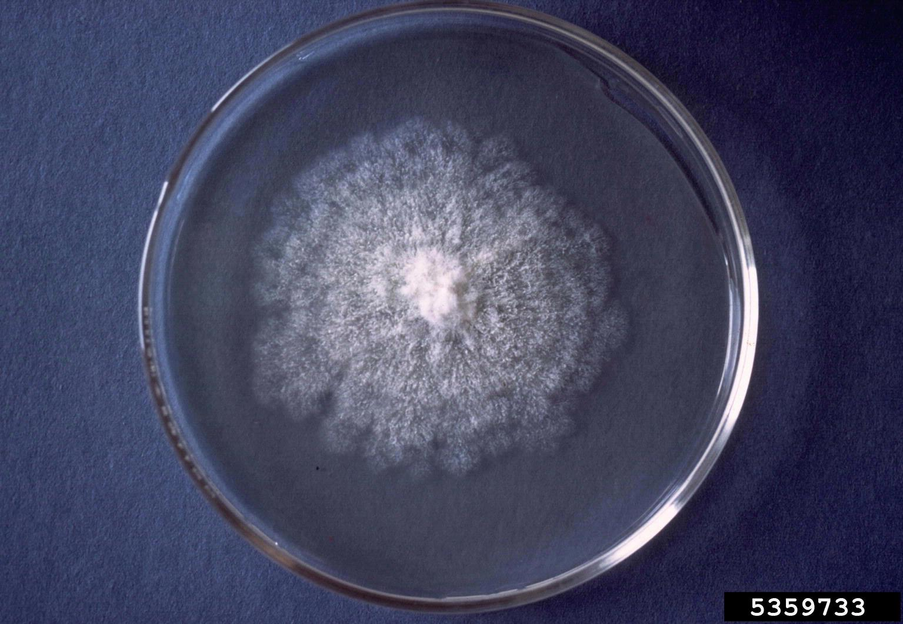
Dutch Elm Disease (DED) Ophiostoma ulmi
Ophiostoma novo-ulmi
Photo: Lester E. Dickens, Bugwood.org
Notes:
Ascomycete fungi or sac fungi
Ophiostoma ulmi – appears in Europe in the 1910s
Imported to USA in the 1920s – from the Netherlands – hence the name.
Ophiostoma novo-ulmi (new strain – or mutation/hybridization of existing species) appears in the 1940s simultaneously in USA and Europe. Some sources suggest this was a “re-import” to Europe from the USA.
23

Slide 24
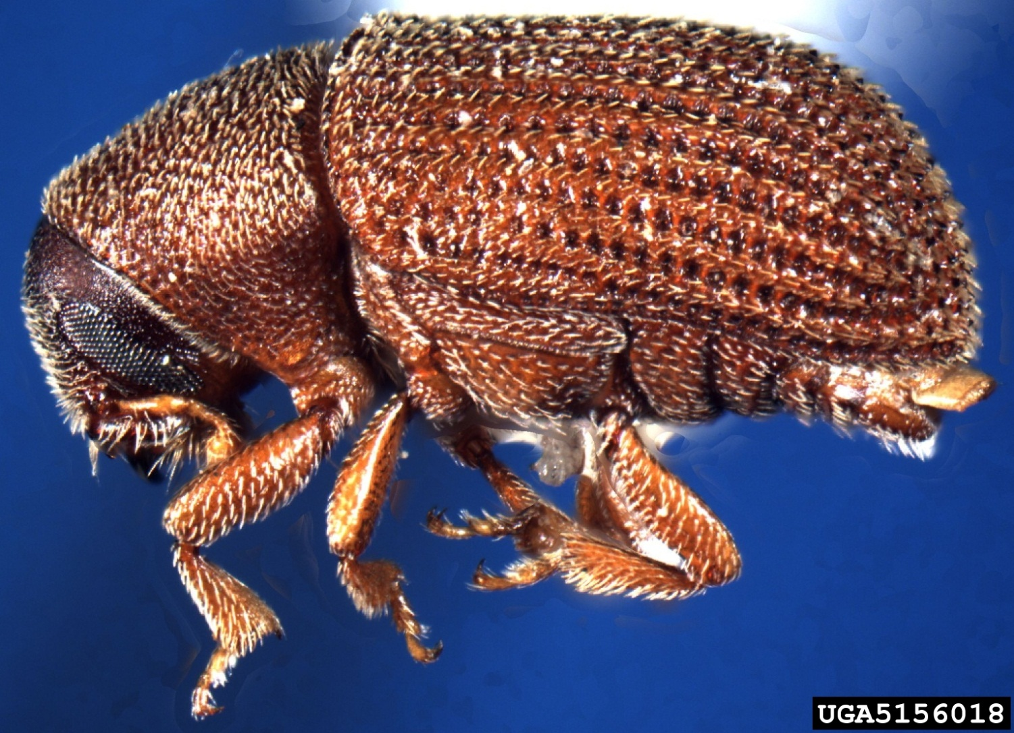
American Elm Bark Beetle Hylurgopinus rufipes
Photo: J.R. Baker & S.B. Bambara, North Carolina State University, Bugwood.org
Notes:
J.R. Baker & S.B. Bambara, North Carolina State University, Bugwood.org
24

Slide 25
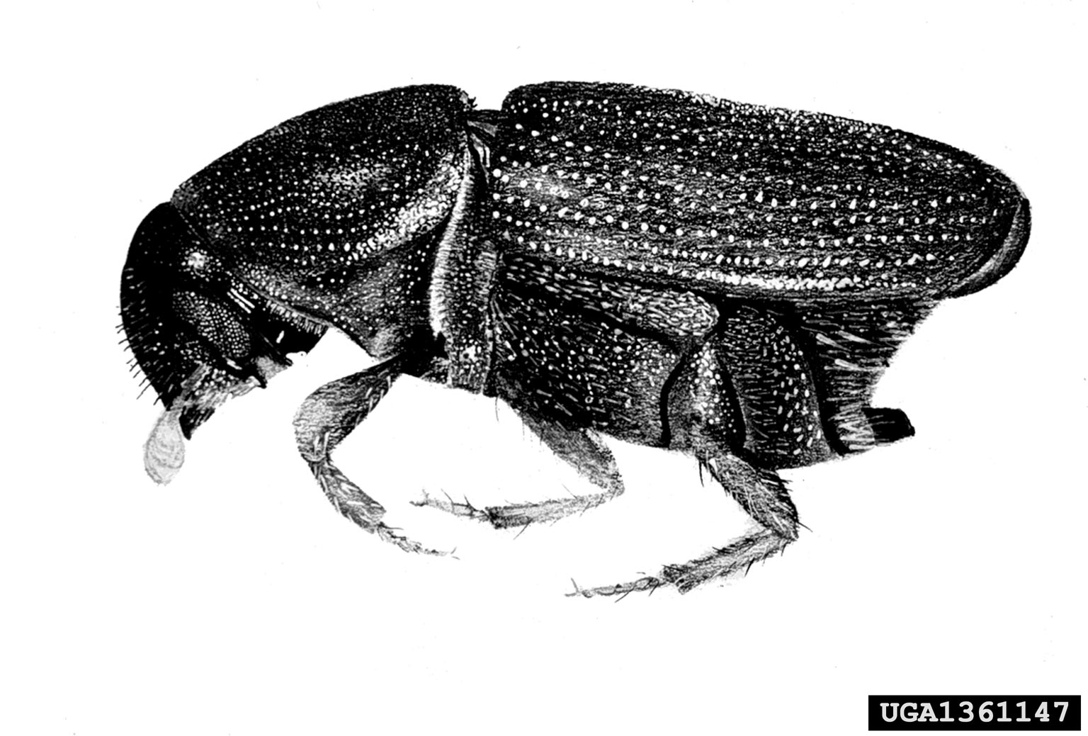
European Elm Bark Beetle Scolytus multistriatus
Photo: USDA Forest Service, Bugwood.org
Notes:
European elm bark beetle
Scolytus multistriatus
Larger and more devastating because of much higher rates of breeding and number of offspring.
25

Slide 26
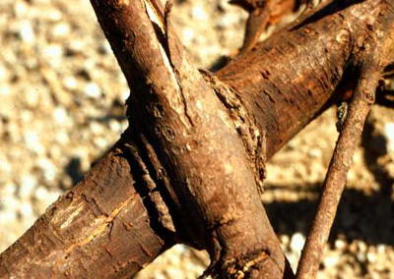
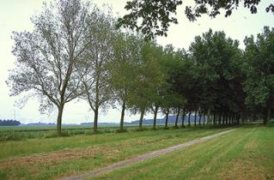
Photo: N. Tisserat, Kansas State University, Manhattan, KS, USA
Photo: H. Kaljee, OMEGAM Groenadvies, Amsterda, The Netherlands
Notes:
Root grafting causes the disease to spread like wildfire down streets and boulevards lined with elms.
26

Slide 27
Dutch Elm Disease in Minneapolis
1963 - First Diseased Elms Found
1963 - 1975 Few Elm Losses
Less than 2,000 trees
1976 - Dutch Elm Disease Crisis
Over 7,000 trees lost
1977
Losses Peak - 32,000 Trees Removed
Notes:
DED was first discovered in Saint Paul in 1961

Slide 34
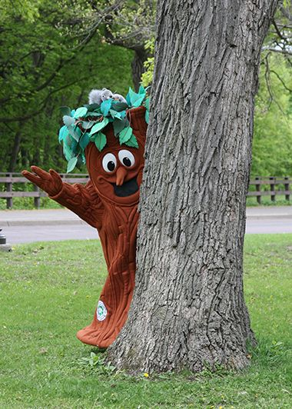

Slide 35
Elm Population in Minneapolis
Pre-1963
Over 90% American Elm
Over 200,000 in Minneapolis Alone
Currently
About 20,000 elms growing in Minneapolis
Most are “disease-resistant” replacements
and one Elmer…
Notes:
1912 – Minneapolis Park Board Commissioners Recommended planting over 2,000 elms JUST THAT YEAR!
Average stem diameter is relatively large, so we have a population of trees that is generally weighted on the older side – still a vulnerable population.

Slide 36
200,000 Trees Planted
in Response to
Dutch Elm Disease

Slide 37
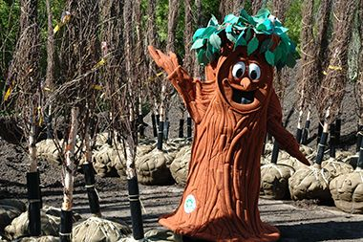
Nice job everyone!!
Notes:
2004
Maple 30%
Linden 19%
Ash 17%
Elm 12%
Hackberry 5%
Honeylocust 7%
Other 10%

Slide 38
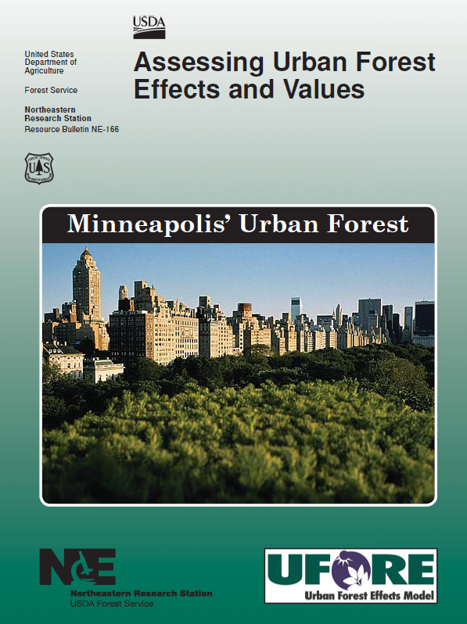
Notes:
Minneapolis Park & Recreation Board
Maintains:
600,000 trees (400,000 park & 200,000 blvd)
179 parks
1,100 miles of streets
Each tree saves $100 year taxpayers
Between energy savings and storm water mitigation trees in Minneapolis save about $11 million per year.
Trees reduce runoff creating cleaner drinking water mitigating 200 million gallons of storm water processing ($5.9 million in savings)
Trees reduce the need for cooling in the summer and heating in the winter ($5.8 million in energy savings)

Slide 39
Pest Impacts
EAB
22% Canopy Loss
$148M Structural Value Loss
ALB
68% Canopy Loss
$487M Structural Value Loss

Slide 40
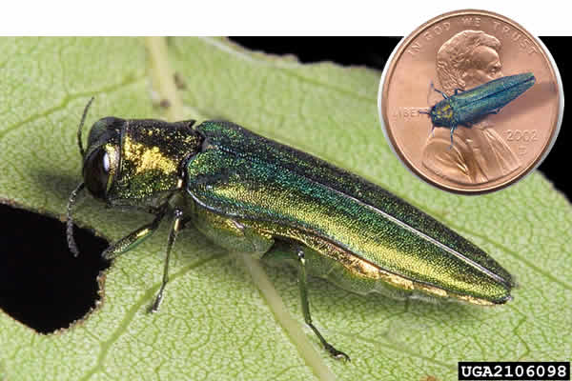
Emerald Ash Borer (EAB)
Photo: David Cappaert, Michigan State University, Bugwood.org.
Notes:
Many communities in MN have ash canopy at 30% or greater, especially in southern and southwestern parts of greater Minnesota.
Many are in the 10 to 20% ash population range.
Most communities have ash populations of at least 10%.

Slide 41
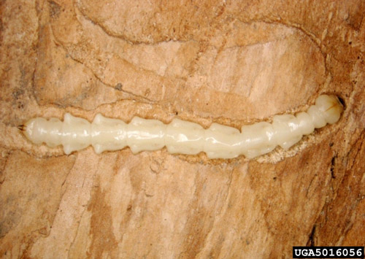
Photo: Pennsylvania Department of Conservation and Natural Resources – Forestry Archive
Notes:
Agrilus plannipennis
Buprestidae = flat-headed borers
Credit: Pennsylvania Department of Conservation and Natural Resources – Forestry Archive

Slide 42
Photo: David Cappaert, Michigan State University, Bugwood.org

Slide 43
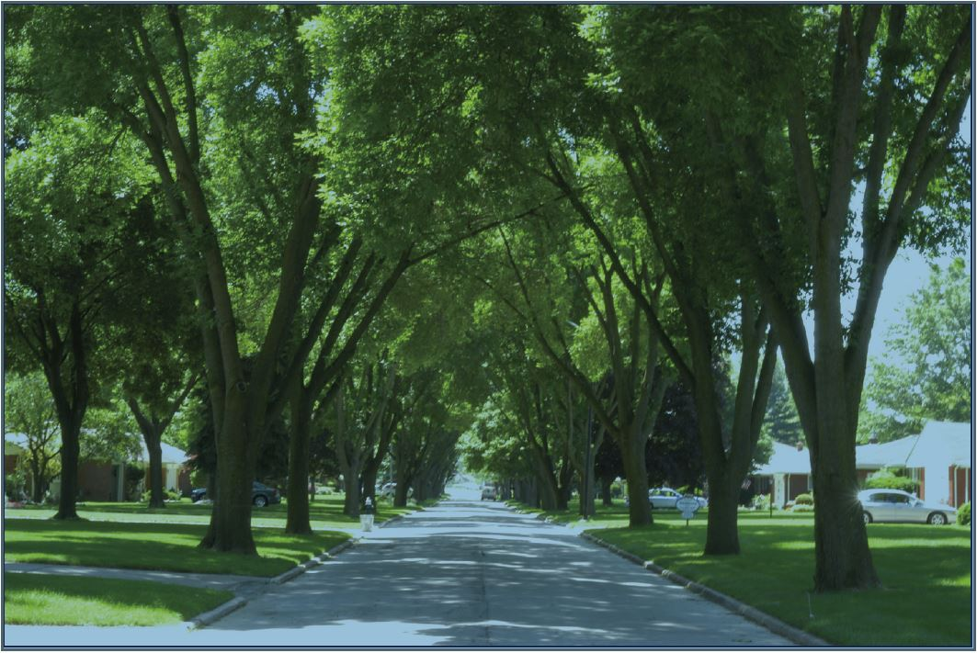
Photo: Dan Herms – The Ohio State University
Notes:
Photo Dan Herms

Slide 44
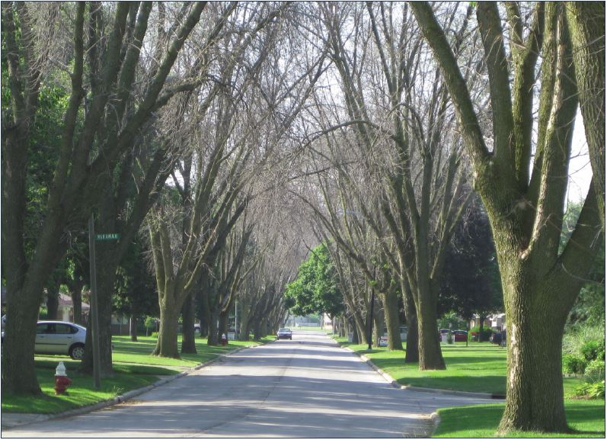
Photo: Dan Herms – The Ohio State University
Notes:
Photo Dan Herms
“The spread of the emerald ash borer, which poses no direct threat to humans but
has killed more than 100 million trees in the United States, was associated with an
additional 15,000 human deaths from cardiovascular disease and an additional 6,000
deaths from lower respiratory disease.”
“Human mortality increased the longer emerald ash borer was present in a county,
consistent with the progression of the insect infestation. Infected trees typically die
within 2 to 7 years.”
“More human deaths occurred in wealthier counties, where trees usually are more
abundant.”

Slide 45
EAB Preparation in Minneapolis 2014-2021
All public ash trees will be removed and replaced
30,000 in public boulevards
10,000 in public parks
Ash trees will be replaced with a diverse mix of new species
Including disease-resistant elms…

Slide 46
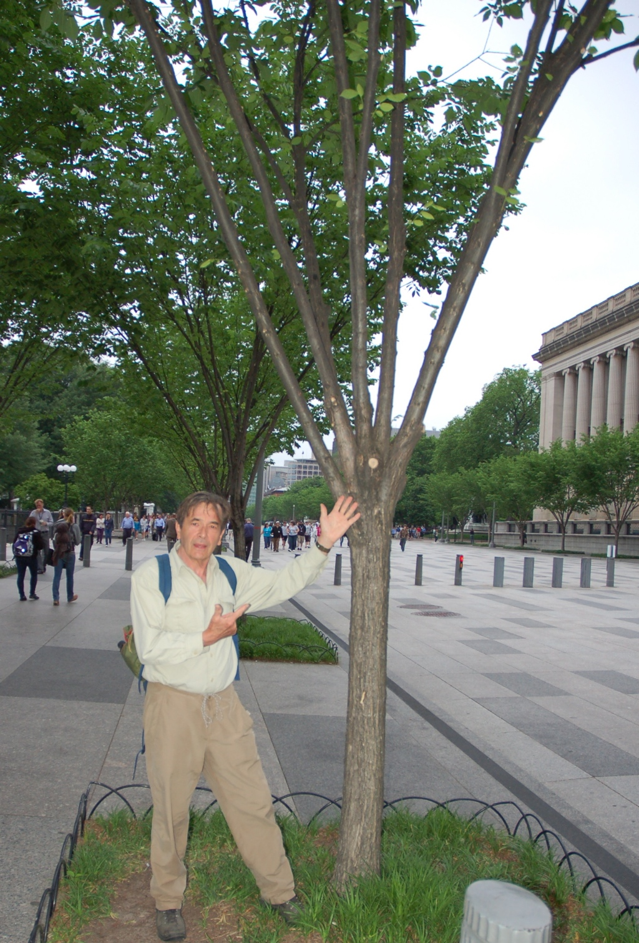
Photo© Tom Zetterstrom

Slide 47
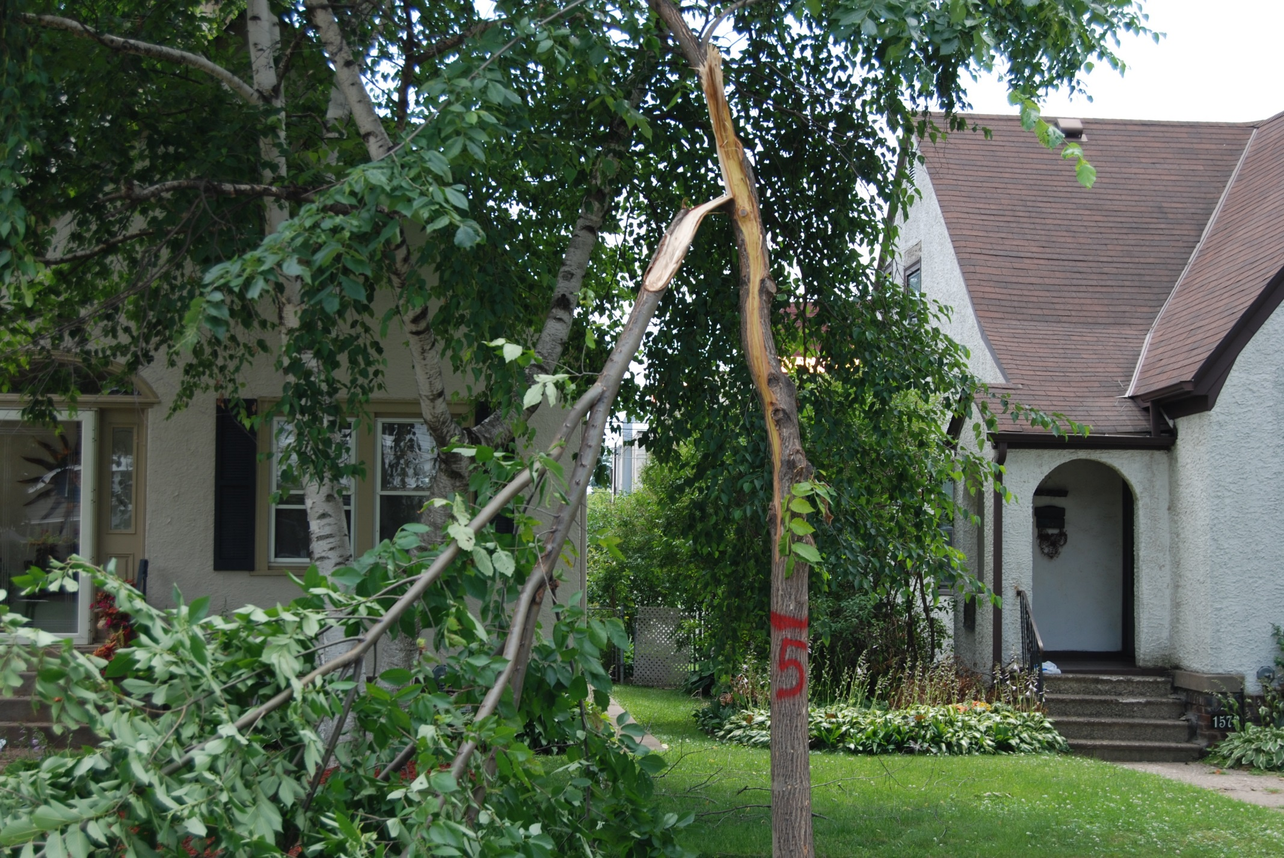
Notes:
Another fatal tear out on Valley Forge

Slide 48
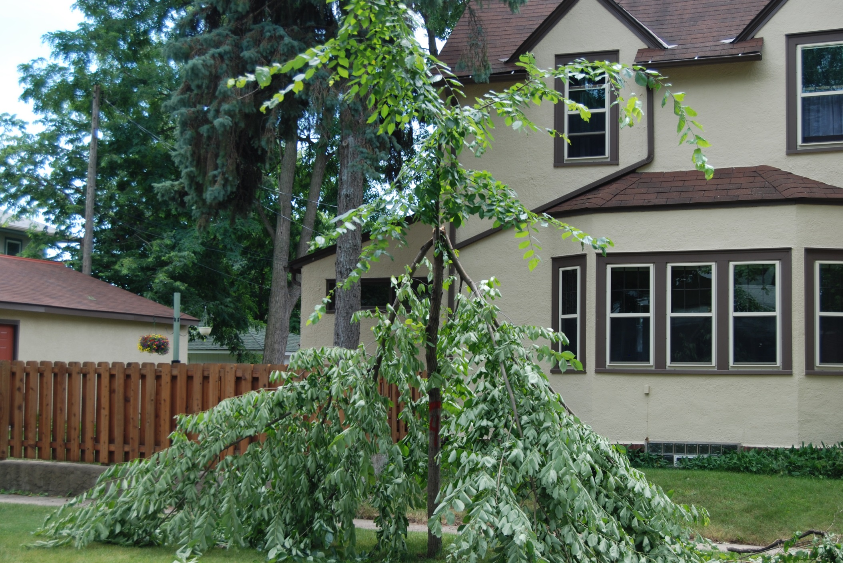
Notes:
Another fatal tear out on Valley Forge

Slide 49
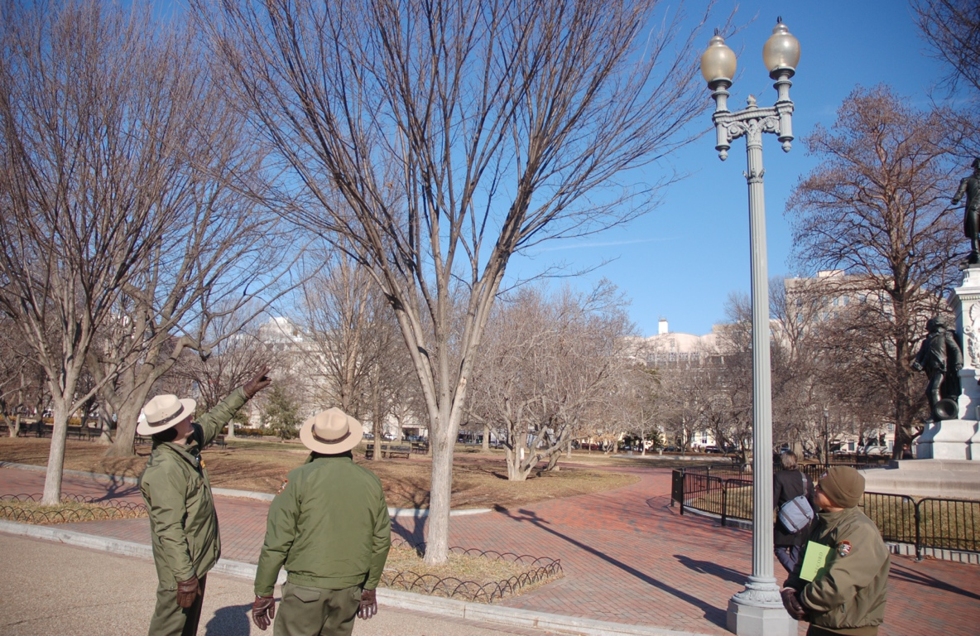
Photo© Tom Zetterstrom

Slide 50
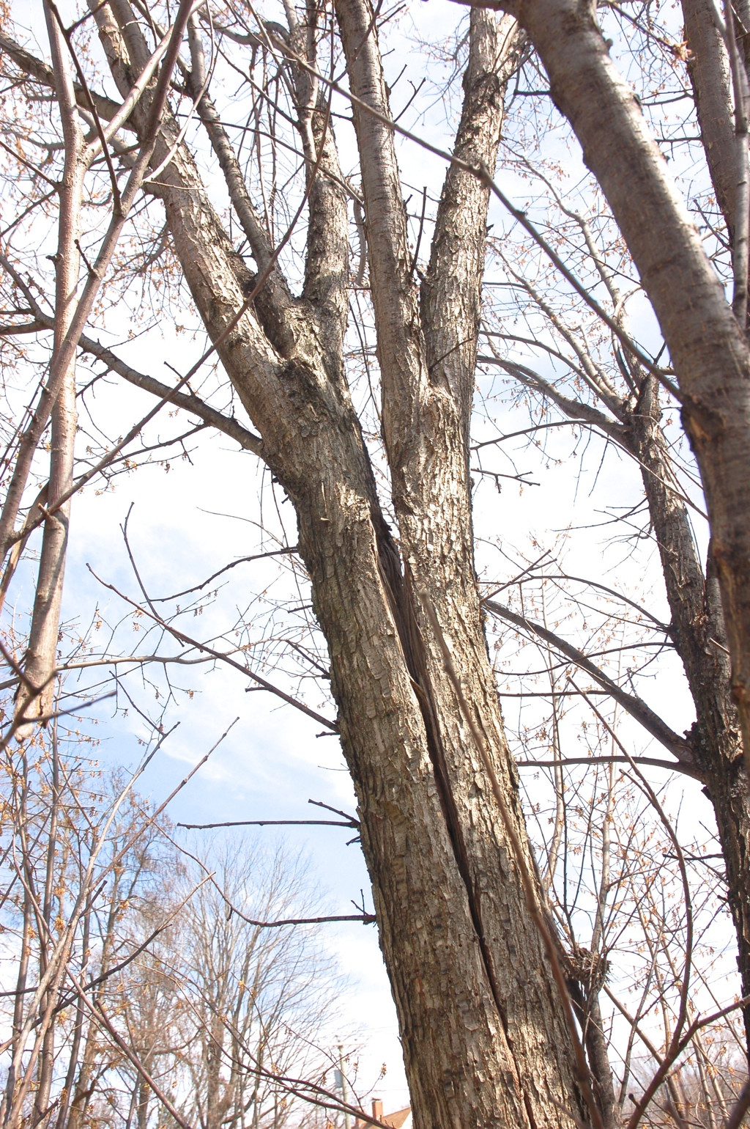
Photo: Tom Zetterstrom

Slide 51
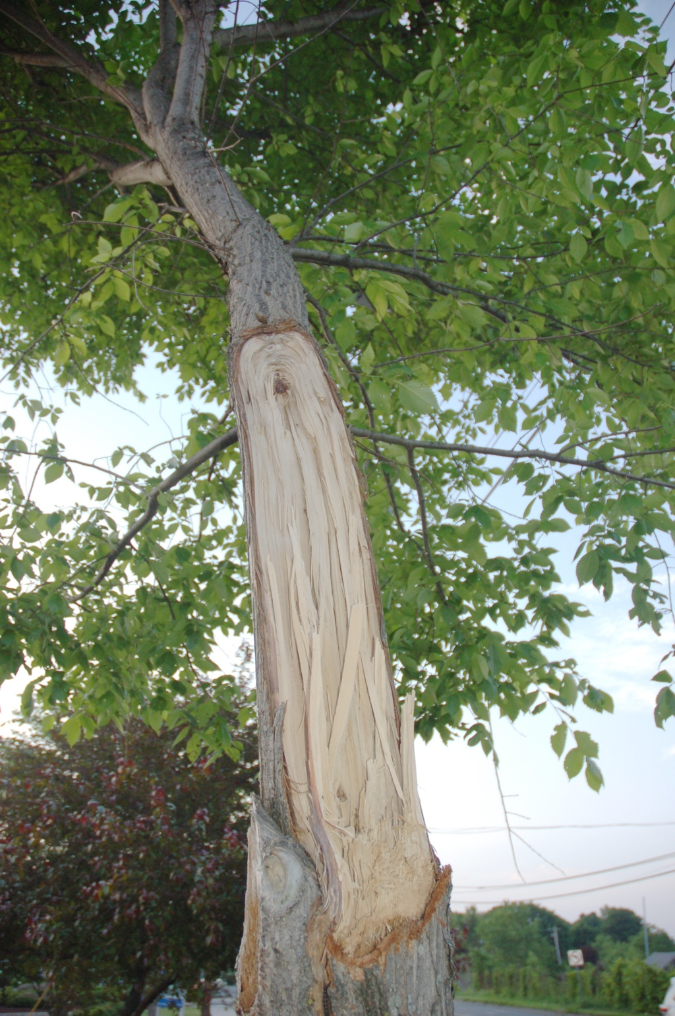
Photo© Tom Zetterstrom

Slide 52
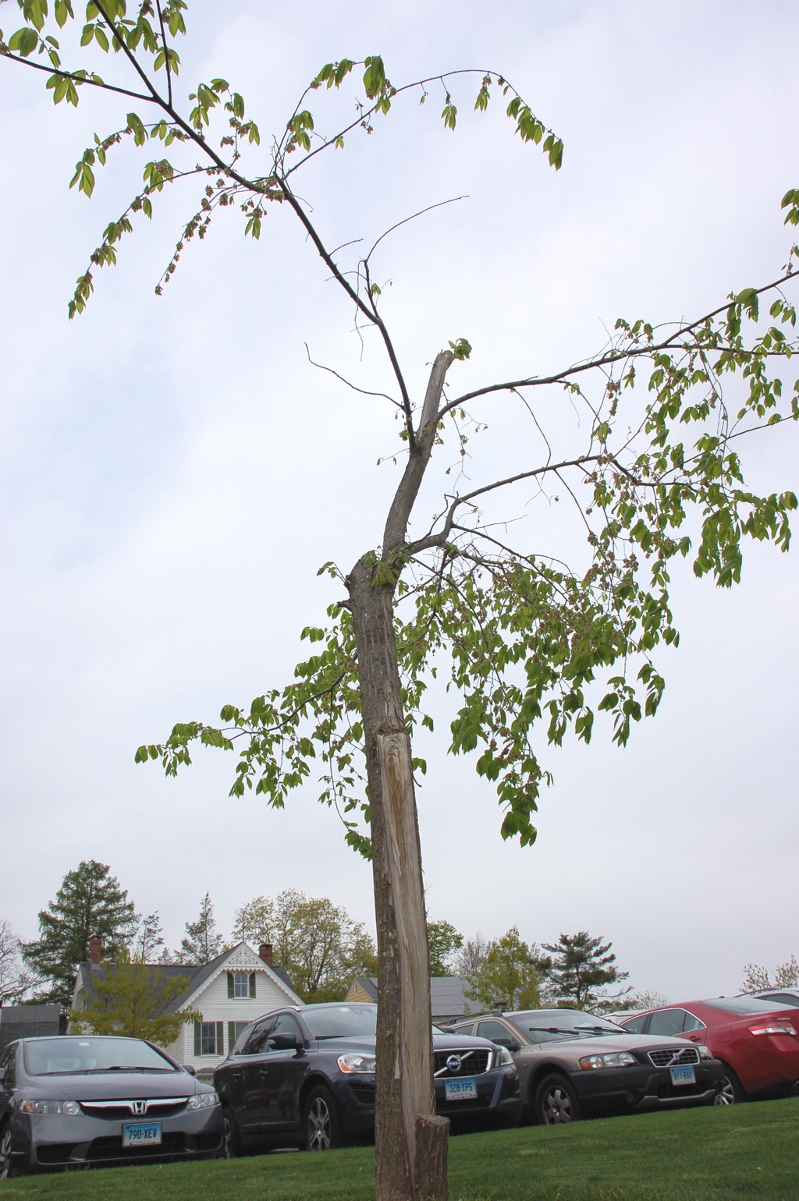
Photo© Tom Zetterstrom

Slide 53
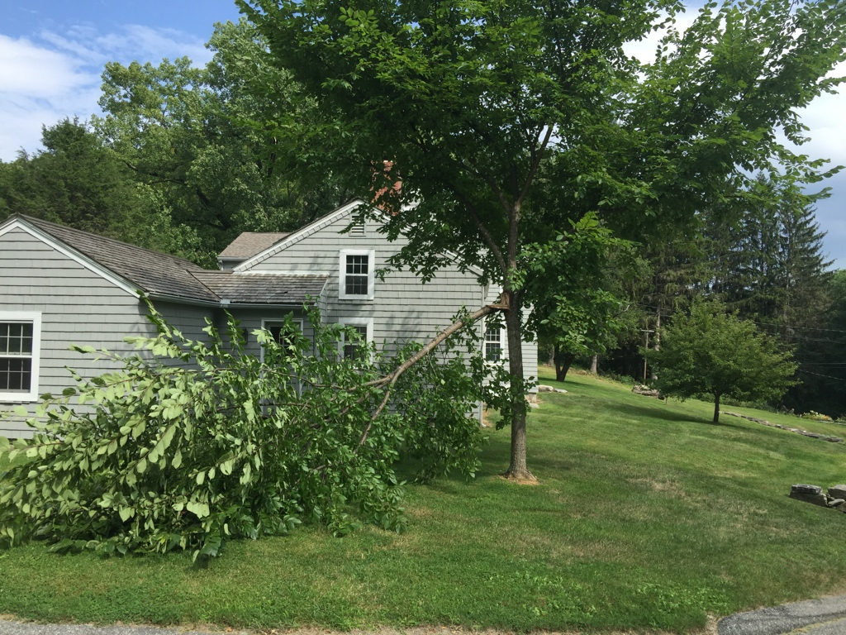
Photo© Tom Zetterstrom

Slide 54
Asian Longhorned Beetle (ALB)
Not currently present in Minnesota or Wisconsin
Most areas that have had infestations have achieved eradication
Future threat?
Probably!

Slide 55
Photo: University of Massachusetts Extension
Notes:
Cerambycidae
Ash (Fraxinus)
Birch (Betula)
Elm (Ulmus)
Horsechestnut and Buckeye (Aesculus)
Katsura (Cercidiphyllum)
London planetree and Sycamore (Platanus)
Maple (Acer)
Mountain Ash (Sorbus)
Poplar (Populus)
Willow (Salix)

Slide 56
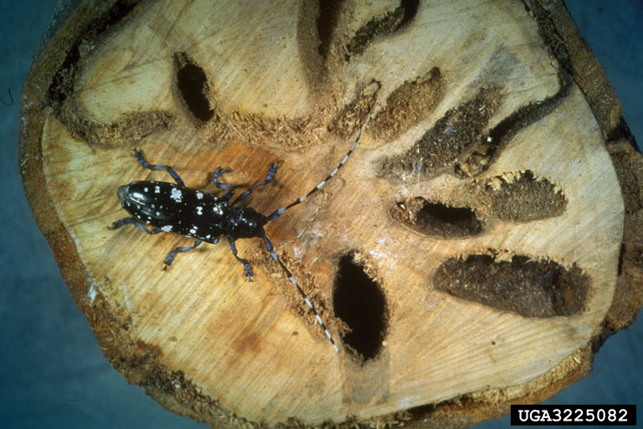
Photo: E. Rirchard Hoebeke, Cornell University, Bugwood.org

Slide 57
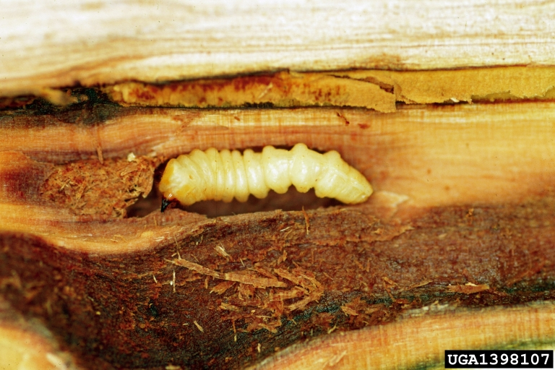
Photo: Steven Katovich, USDA Forest Service, ForestryImages.org

Slide 58
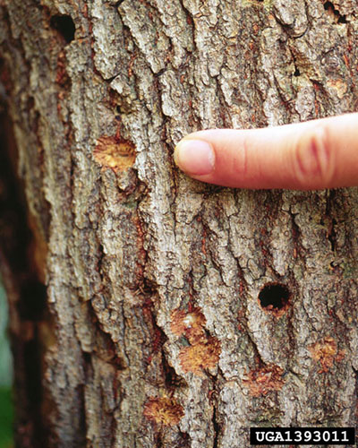
Dennis Haugen, USDA Forest Service, ForestryImages.org

Slide 59
21st Century Urban Forestry is All About Diversity
Plant LARGE shade trees
Plant FEWER ALB host trees
Birch, Buckeye, Maple, Elm, Planetree
Neighborhood-Level Diversity
Maximum of 10% of any one genus
Block-Level Diversity
Three to five genera
Maximum of five trees per genus
Maximum of 10 trees that are ALB hosts

Slide 60
Non-ALB Host Trees
Ginkgo
Honeylocust
Hackberry
Oaks
Lindens
Tamarack/Larch
Corktree
Rose Family
Amur Maackia
Coffeetree
Alder
Ironwood
Tree Lilac

Slide 61
Contacts & Links
Chad Giblin
giblin@umn.edu
Urban Forestry Outreach, Research & Extension (UFore) Nursery and Lab
trees.umn.edu

Slide 62
Thanks!
Environment & Natural Resource Trust Fund
Minneapolis Park & Recreation Board
City of Saint Paul – Parks & Recreation
Minnesota Turf & Grounds Foundation
MN Department of Natural Resources
United States Forest Service
Minnesota State Capitol
Minnesota Nursery & Landscape Association

